Slide 1
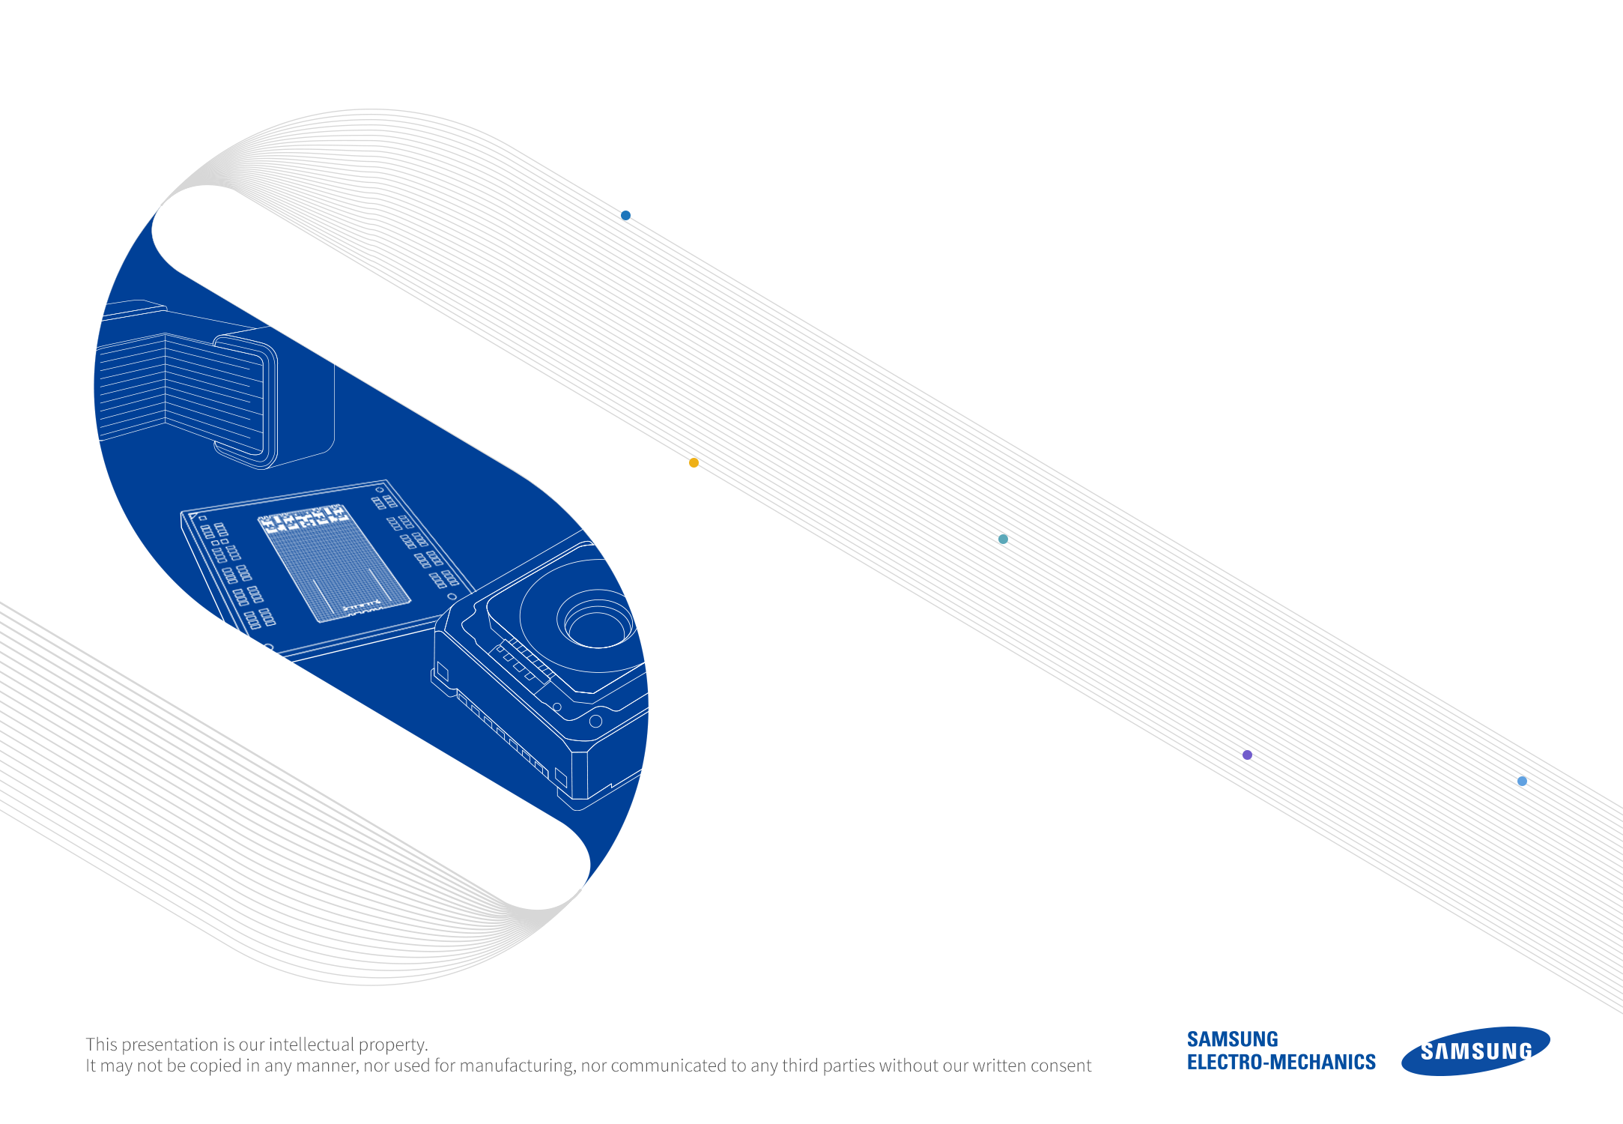
CONFIDENTIAL
Samsung Library Install Guide
For ADS
NOVEMBER, 2024

Slide 2

CONFIDENTIAL
Part 1
Operation environment
Part 2
How to Install Samsung Library
Part 3
How to Use Samsung Library
Part 4
Contact

Slide 3
CONFIDENTIAL
Notice
1.This Simulation Model is provided solely for reference purposes. For the characteristics of products, you have to refer to the Specifications.
2.In no event shall Samsung Electro-Mechanics be liable for any loss or damage arising, directly or indirectly, from, in connection with your reliance on any information contained in the Simulation Model, including, but not limited to any loss or damages arising from any inaccuracies, omissions or errors in connection with such information.
3.Samsung Electro-Mechanics does not make any warranty, express or implied, including but not limited to the correctness, implied warranties of merchantability and fitness for a particular purpose with respect to this Simulation Model. Any information contained in the Simulation Model is subject to modifications or changes by Samsung Electro-Mechanics without any prior notice.

Slide 4
01.
Operation environment
This document is described under the following environment conditions.
Supported Platforms : ADS Supported Platforms - ADS Supported Platforms - Keysight Knowledge Center
System Requirements : Home - Home – Keysight Knowledge Center

Slide 5
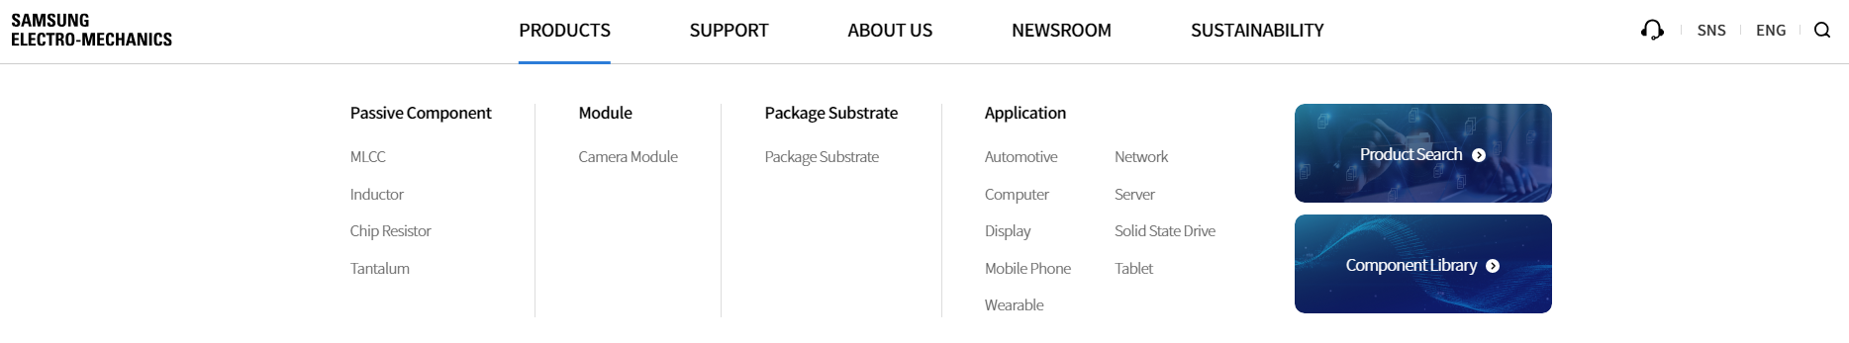
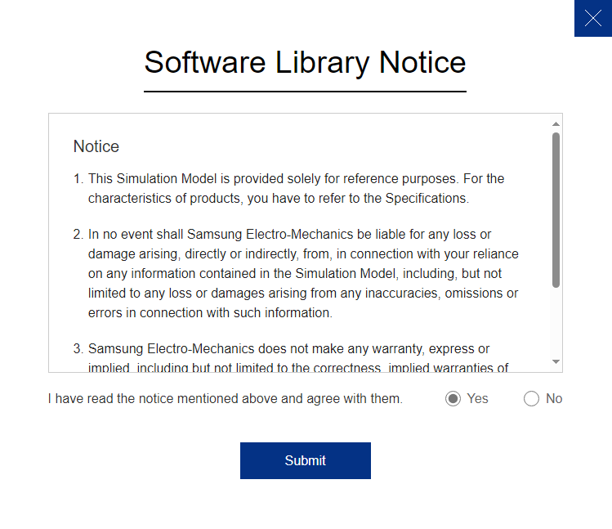
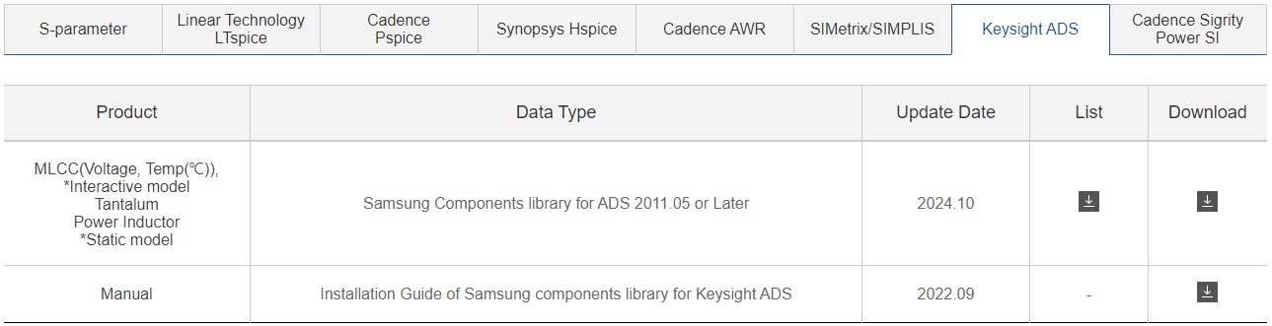
02.
How to Install Samsung Library (1)
If you have the previous version of Samsung Library, please uninstall the library at first and
download the latest library in our homepage.
* HOME PAGE > PRODUCTS > Component Library > Keysight ADS
* HOME PAGE > SUPPORT > Technical Resources > Software Library > Keysight ADS
1
2
3
4
5

Slide 6
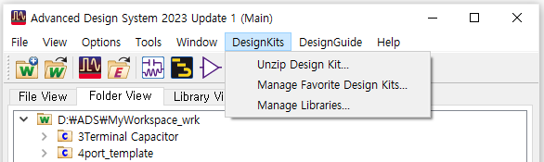
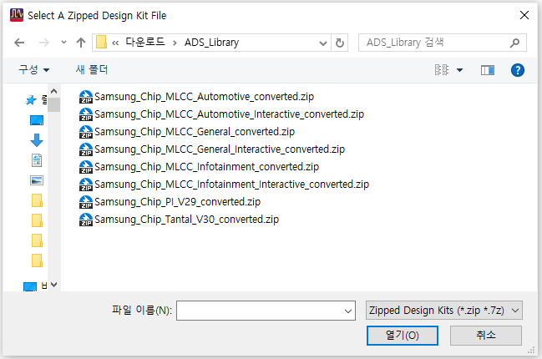
02.
How to Install Samsung Library (2)
Select ‘DesignKits’ > ‘Unzip Design Kit…’ in main window
Select the downloaded file (*.zip) and click ‘Open’ button in pop-up window
1
2
3

Slide 7
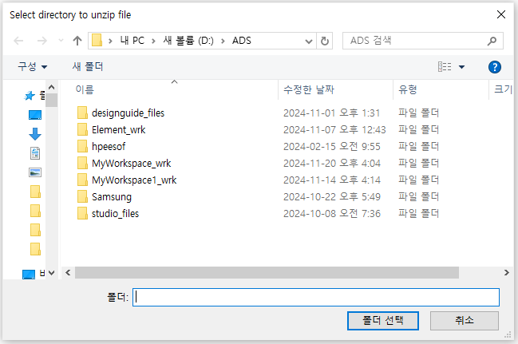
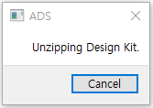

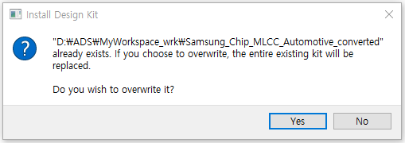
02.
How to Install Samsung Library (3)
Select the directory to unzip file (ADS workspace folder you created) and
click ‘Choose’ button in pop-up window
After unzipping for a moment, ‘Add Design Kit’ window appears. Click ‘Yes’ button
1
2

Slide 8
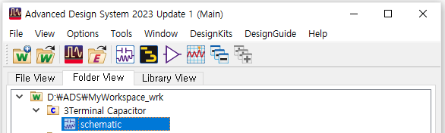
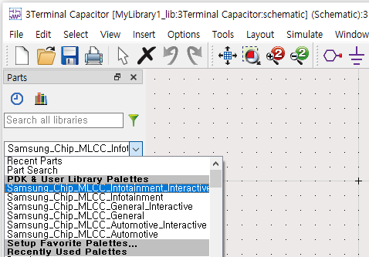
03.
How to Use Samsung Library (1)
Open your ADS workspace that Samsung Library was installed.
then, create or open the schematic window.
Select Samsung Components at pallet list in the schematics window.
1
2

Slide 9
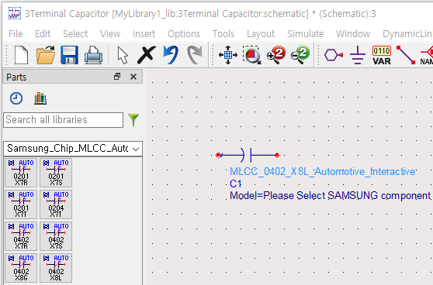









03.
How to Use Samsung Library (2)
Click the component icon and put down on the schematic sheet.
Other Components
(Component Icon)
(Precise Interactive library)
→ MLCC_Automotive_Interactive, MLCC_Automotive, MLCC_Infotainment_Interactive,
MLCC_Infotainment, MLCC_General_Interactive, MLCC_General, P.I, Tantal

Slide 10

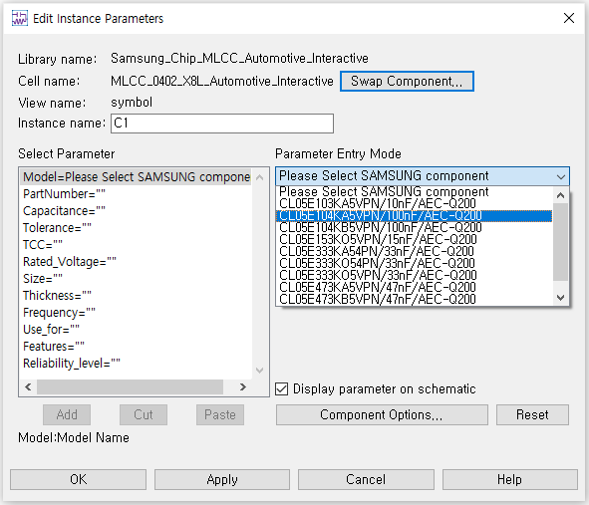
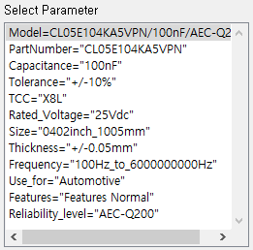
03.
How to Use Samsung Library (3)
Double-click the symbol to display the window. Click ‘Please Select…’ in the ‘Parameter Entry Mode’
You can select products from the dropdown list, click ‘Apply’ and ‘OK’ button.
1
2
4
3

Slide 11
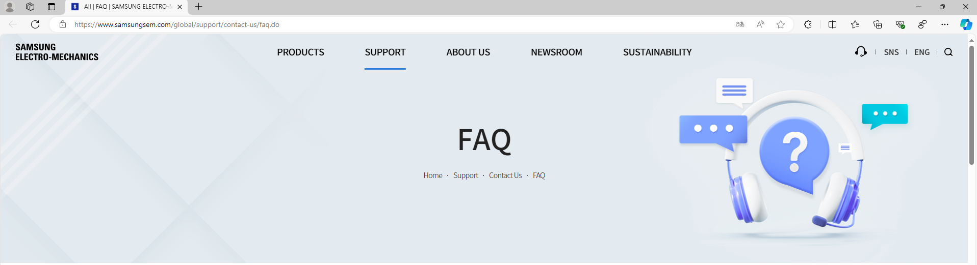
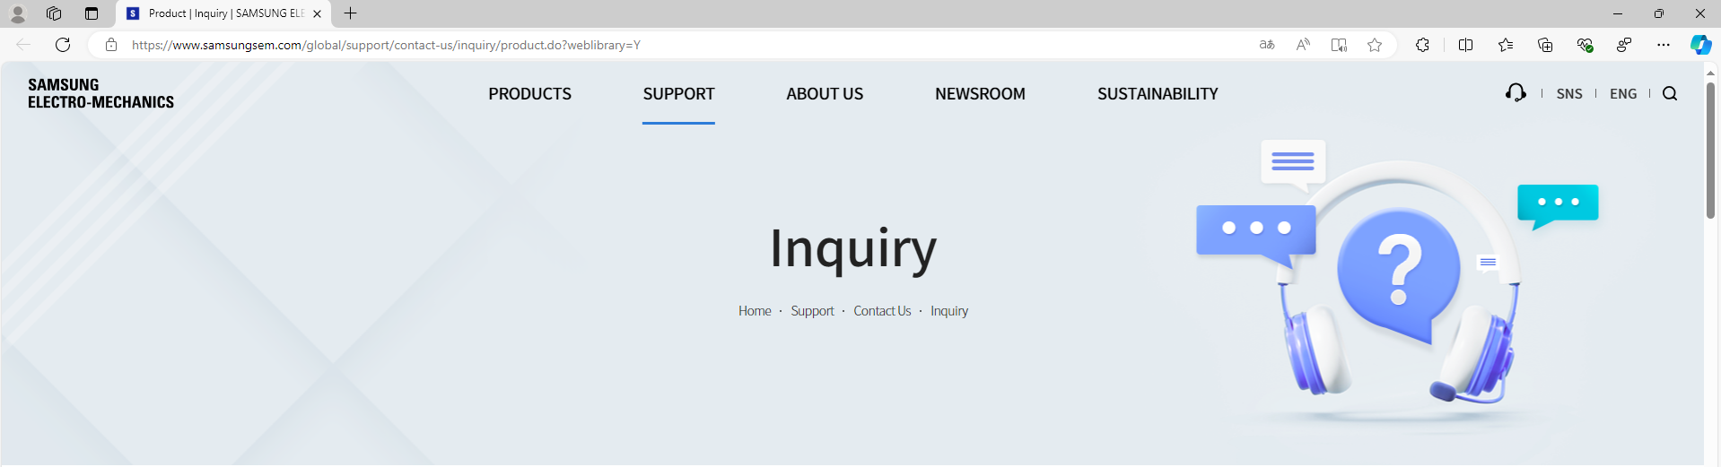
04.
Contact
If you have any questions about this library, please contact our website
All | FAQ | SAMSUNG ELECTRO-MECHANICS (samsungsem.com)
Product | Inquiry | SAMSUNG ELECTRO-MECHANICS (samsungsem.com)

